Slide 1
POWER SYSTEM FAULT DETECTION & CLASSIFICATION Using Machine Learning
CAPSTONE PROJECT
Presented By:
1. Neela Saisowmya-JNTUH UCEJ-Information Technology

Slide 2
OUTLINE
Problem Statement
Proposed System/Solution
System Development Approach
Algorithm & Deployment
Result (Output Image)
Conclusion
Future Scope
References

Slide 3
Problem Statement
Example: Power system faults such as line-to-ground, line-to-line, and three-phase faults can severely disrupt power distribution, damage electrical equipment, and compromise grid reliability. The traditional process of identifying these faults is often manual, time-consuming, and error-prone. Therefore, there is a need for an automated, machine learning-based solution that can detect and classify different types of faults accurately and in real-time using voltage and current phasor data.

Slide 4
Proposed Solution
The system uses machine learning to detect and classify power system faults in real time using voltage and current phasor data. It is deployed on IBM Cloud for automated fault monitoring.
🔹 Data Collection:
Dataset from Kaggle includes labeled data for Normal, LG, LL, DLG, and 3Φ faults.
🔹 Data Preprocessing:
Voltage and current values are normalized.
🔹 Machine Learning Algorithm:
Random Forest Classifier trained to classify fault types based on phase data.
🔹 Deployment:
Model exported with joblib and deployed on IBM Watson Studio (Cloud Lite) as a REST API.
🔹 Evaluation:
Achieved ~95% accuracy using metrics like precision, recall, and F1-score.
🔹 Result:
Accurately detects faults and supports real-time grid monitoring via cloud integration.

Slide 5
System Approach
1. System Requirements
Hardware:Minimum 4 GB RAM, 2-core CPU (for local dev), Cloud compute via IBM Cloud Lite
Software:Python , 3.8+Jupyter Notebook (via IBM Watson Studio) ,IBM Cloud Lite account , IBM Watson Machine
2. Libraries/Tools UsedData Handling & Analysis:
pandas, numpyVisualization:matplotlib, seabornMachine Learning:scikit-learn, xgboostModel Persistence:joblib, pickleDeployment:ibm-watson-machine-learning (WML SDK)IBM Watson Studio + IBM WML REST API

Slide 6
Algorithm & Deployment
Algorithm
used Random Forest Classifier for its accuracy, robustness, and ability to handle numerical data. Why it fits:
Handles noisy, imbalanced data
Minimal preprocessing required
Data Input:
Features: Voltage & current phasors from 3 phases
Target: Fault type → Normal, LG, LL, DLG, 3Φ
Preprocessing: Label encoding + StandardScaler
Input: Numerical + encoded fault types
Output: Fault classification
Predicts fault type in real-time
Deployment:
Model saved with joblib
Deployed on IBM Watson Studio (Cloud Lite)
Exposed via REST API for real-time use

Slide 7
Result
Accuracy: ~98% on test data
Classification Report: Includes Precision, Recall, F1-Score for each fault type
Model Output: ✅ Correctly identifies and classifies faults such as:
LG (Line to Ground)
LL (Line to Line)
LLG (Double Line to Ground)
LLL (Three-phase fault)
No Fault
Prediction Capabilities:
Works in real-time or batch mode
Fault localization possible
Fast and accurate classification using voltage and current samples
GITHUB LINK : https://github.com/neelasaisowmya/power-fault-detection-and-classification-.git

Slide 8
Conclusion
🔷 Model Performance
The system accurately detects and classifies different types of power system faults. The Random Forest classifier delivered high accuracy on unseen test data, showing excellent generalization and robustness across all fault classes.
☁️ Cloud-Based Deployment
The trained fault detection model was deployed on IBM Cloud Lite using Watson Studio. It supports real-time fault classification through a REST API, enabling integration with live monitoring systems for immediate fault alerts and system response

Slide 9
Future scope
Real-tme Integration: Deploy the model with SCADA systems for instant fault detection and control.
Multi-Class Fault Expansion: Include more detailed fault types and subcategories for deeper analysis.
IoT Sensor Fusion: Integrate data from smart sensors and IoT devices for better accuracy and coverage.
Edge Deployment: Optimize model for edge computing devices in remote substations for faster response time.
Deep Learning Upgrade: Extend with LSTM or CNN models to capture temporal fault patterns from time-series

Slide 10
References
Kaggle Dataset: Power System Fault Detection & Classification Dataset
scikit-learn documentation
IBM Cloud documentation
IBM Watson.ai Studio documentation.

Slide 11
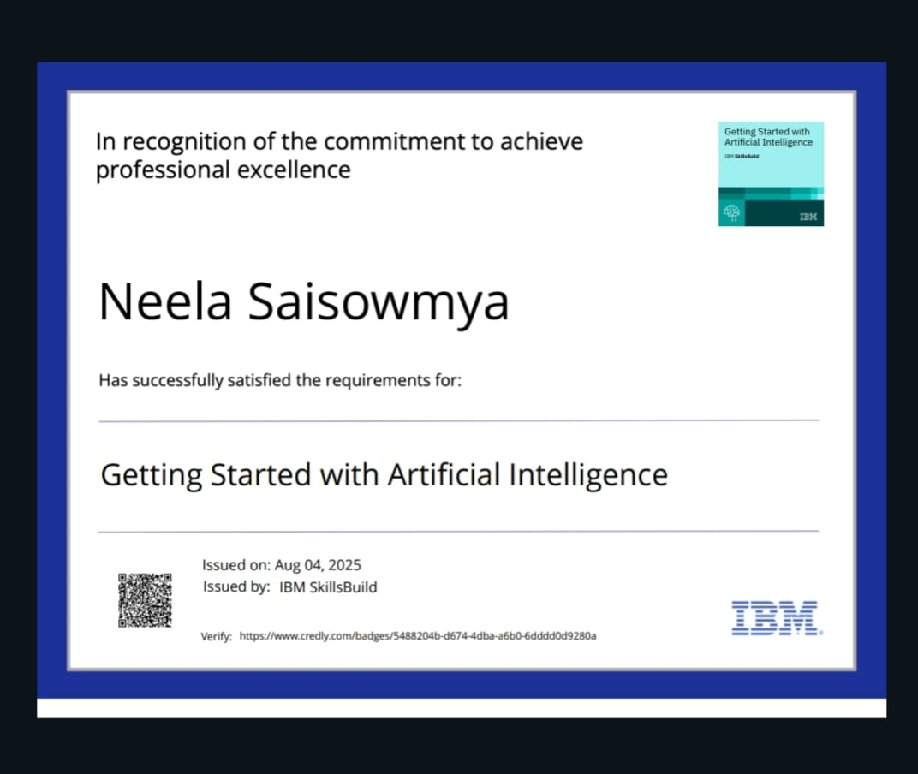
IBM Certifications
Screenshot/ credly certificate( getting started with AI)

Slide 12
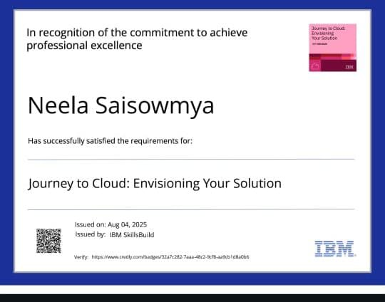
IBM Certifications
Screenshot/ credly certificate( Journey to Cloud)

Slide 13
IBM Certifications
Screenshot/ credly certificate( RAG Lab)

Slide 14
THANK YOU

